Slide 1
GROWTH CHART Presented by Dr. Mahadevi A.L Assistant professor Dept of paediatrics
Growth charts are an important tool used to compare the growth of an individual to the growth of a normal population.
Thus, they may be used to define the abnormal growth of a child and track their progress through time.
The current UK-WHO growth charts combine World Health Organisation standards with UK preterm and birth data to depict a healthy pattern of growth that is desirable for all children, whether breastfed or formula-fed and of whatever ethnic origin.
The growth chart used to plot the measurements of weight, height/length and head circumference should correspond to the child’s sex and age.

Slide 5
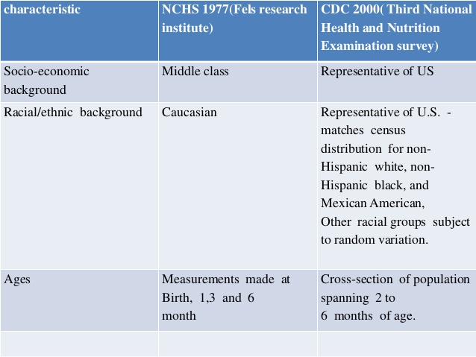

Slide 6
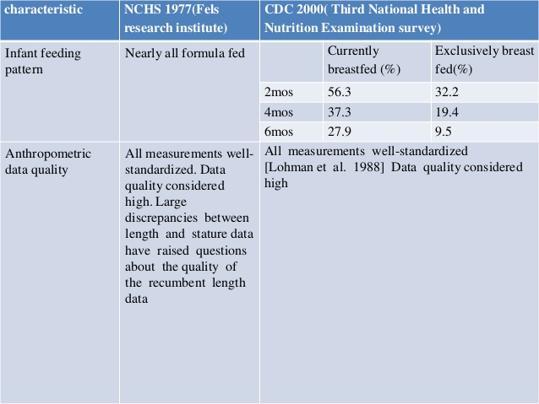

Slide 8
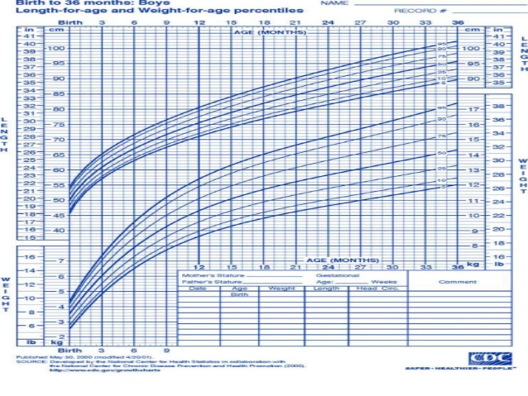

Slide 9
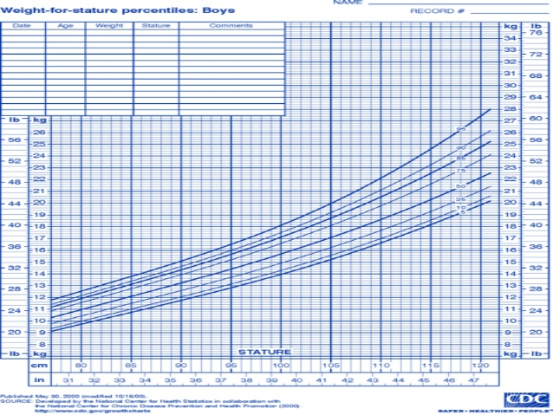

Slide 10
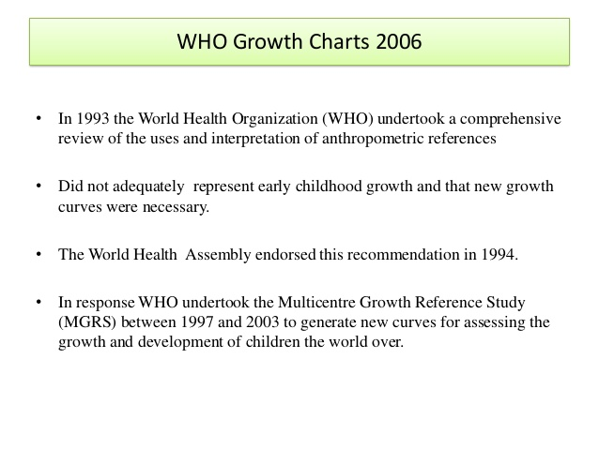

Slide 11
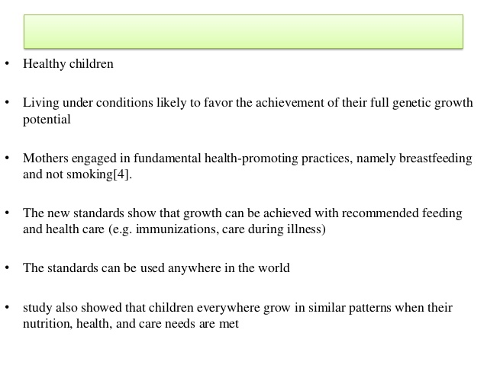

Slide 13
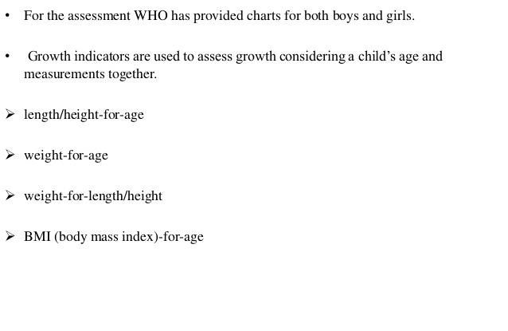

Slide 14
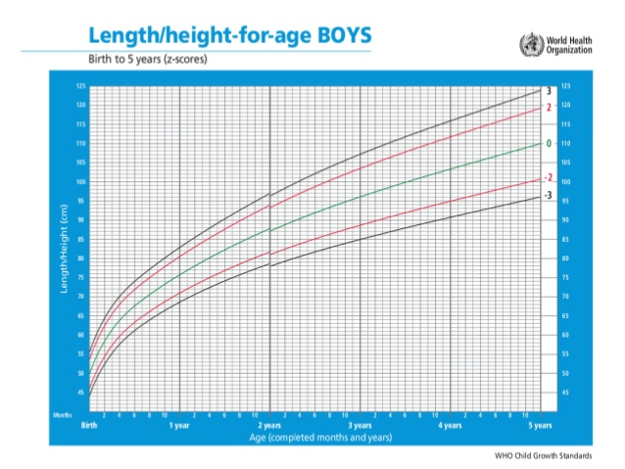

Slide 15
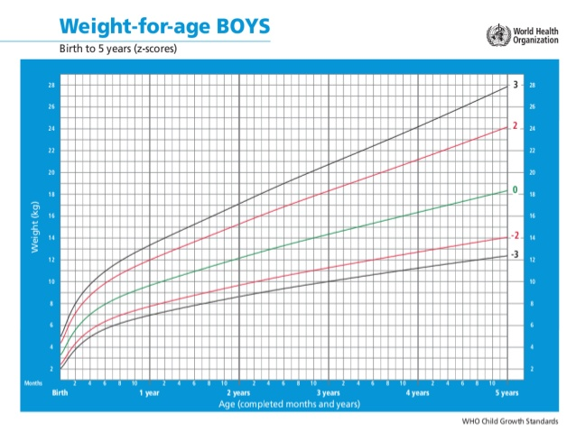

Slide 16
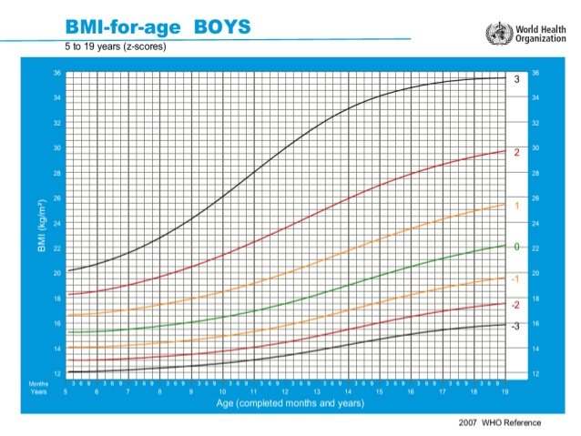

Slide 19
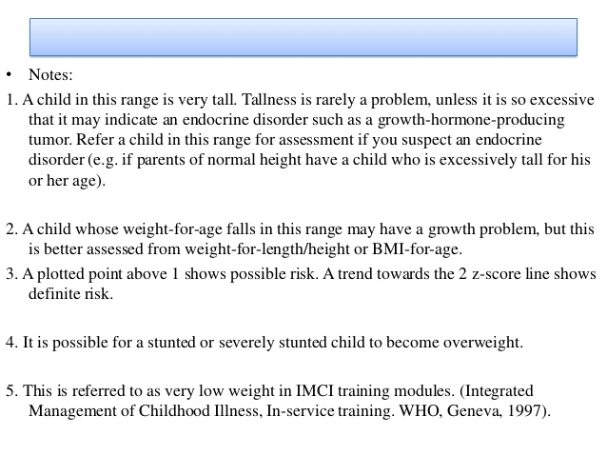

Slide 20
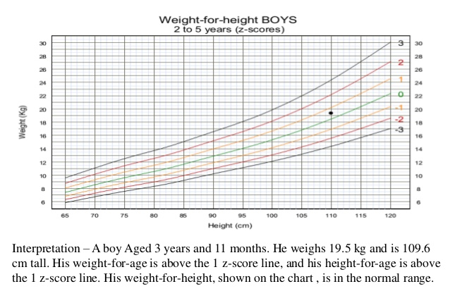

Slide 22
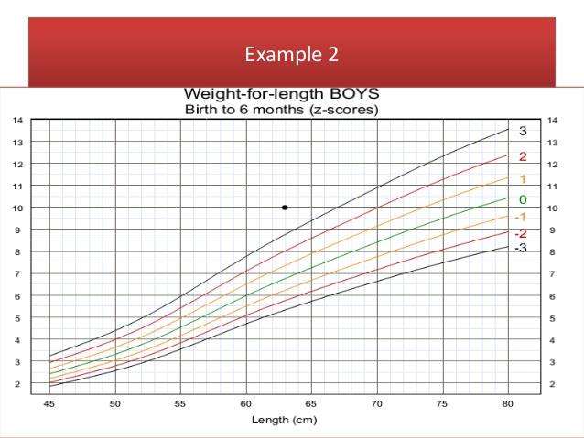

Slide 24
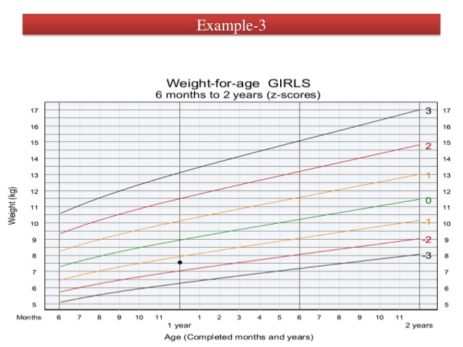

Slide 25
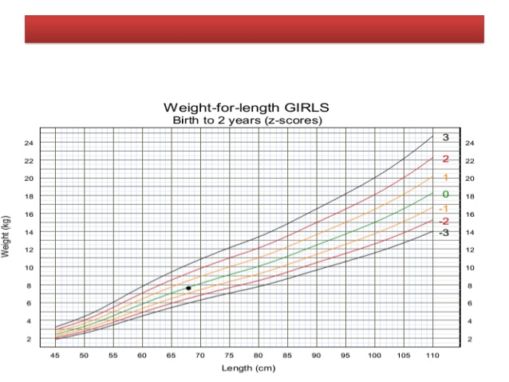

Slide 26
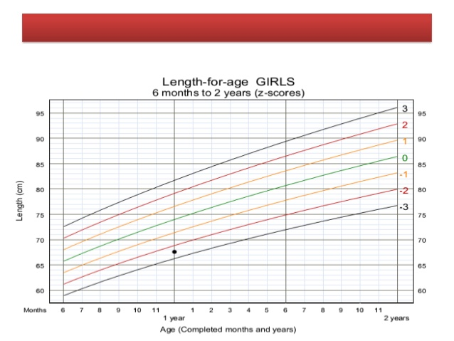

Slide 28
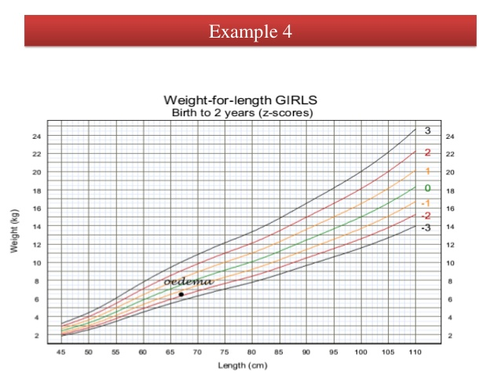

Slide 31
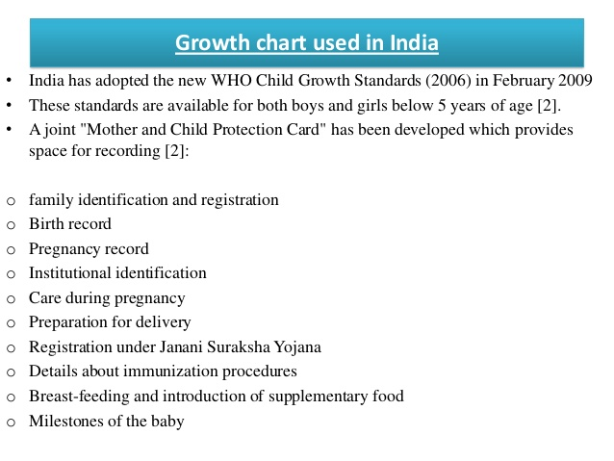

Slide 32
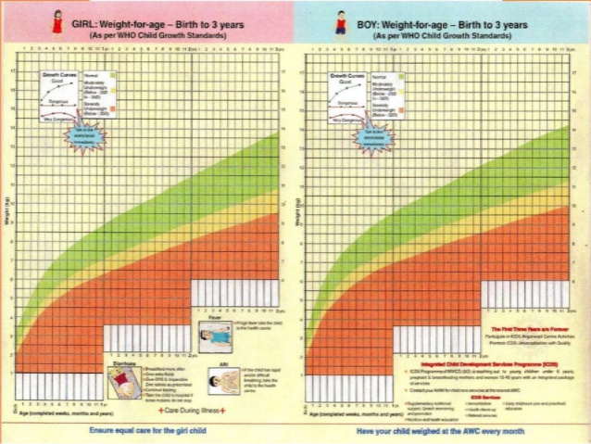

Slide 33
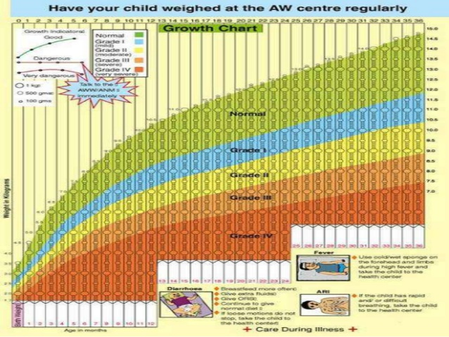

Slide 35
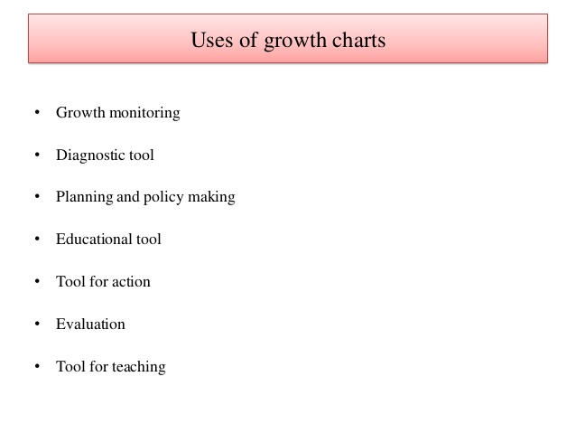

Slide 39
Understanding Percentiles
When your child's doctor measures height, weight, and head circumference, not only will they tell you the results in terms of inches and pounds, they will also express what your child's percentiles are for each measurement. The percentile number means that your child exceeds that percentage of children their age for that measurement.
If your child is in the 75th percentile for height, they are taller than 75% of other kids her age.
If they are in the 25th percentile for weight, they only exceeds 25% of children their age in weight.
However, weight charts do not reflect the obesity epidemic. About one-third of kids are now overweight, meaning that there are many more than 5% of kids above the 95th percentile for weight. The growth curves haven't been adjusted as the intended purpose of the growth charts is to plot out what is typical, healthy growth.

Slide 40
RCPCH growth charts
Copies of the NHS and RCPCH approved growth charts are available online:
0-4 years
Girls
Boys
2-18 years
Girls
Boys
Neonatal and infant close monitoring (NICM)
Girls

Slide 41
Plotting
0-4 years
For babies born at term (>/= 37 weeks), plot each measurement on the relevant chart by drawing a small dot where a vertical line through the child’s age crosses a horizontal line through the measured value – height/length, weight or head circumference (see Fig. 1 below).
Plot birth weight/length/head circumference at age 0.

Slide 42
For pre-term infants
If <32 weeks gestation – the NICM chart should be used.
If >32 weeks and before 37 weeks, plot all measurements in the preterm section until 42 weeks gestation. Then plot on the 0-1-year chart using gestational correction as shown in Fig. 2 (below).
Gestational correction: plot measurements at the child’s actual age, then draw a line back the number of weeks the infant was preterm. Mark the spot with an arrow: this is child’s gestationally corrected centile. This should continue until at least 1 year of age.
2-18 years
Plot each measurement on the relevant chart by drawing a small dot where a vertical line through the child’s age crosses a horizontal line through the measured value – height or weight (see Fig. 1 below).

Slide 43
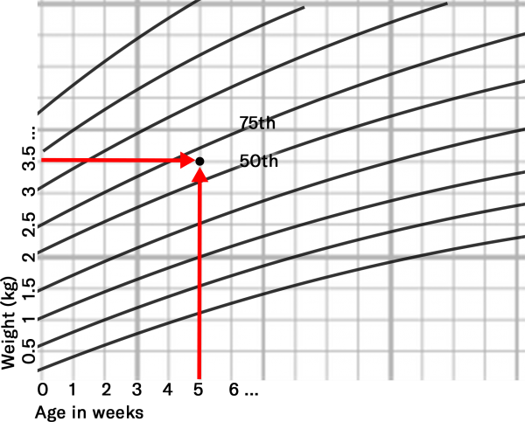

Slide 44
Centile terminology
Below is a summary of some of the key points you should understand when it comes to centiles, with an included chart that illustrates each of the points:
If the point is within 1/4 of a space of the line, they are on the centile (i.e. 91st).
If not, they should be described as being between the two centiles (i.e. 75th-91st).
A centile space may be considered the equivalent distance if midway between centiles.
A centile space may also be considered the distance between two of the centile lines.
Plotting for PRE-TERM INFANTS: Draw a line back the number of weeks preterm and mark with an arrow (Dot = actual age / Arrow = gestational age).

Slide 45
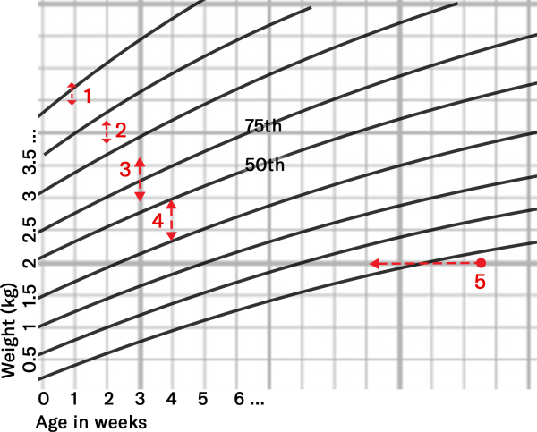

Slide 46
Percentiles
Growth charts indicate:
A child’s size compared with children of the same age and maturity who have shown optimal growth.
How quickly a child is growing.
Centile lines show the expected range of weights and heights (or lengths). They describe the number of children expected to be BELOW that line (i.e. 50% below the 50th, 91% below the 91st):
99 out of 100 children who are growing optimally will be between the two outer lines (0.4th – 99.6th centiles).
Half will lie between the 25th and 75th centile lines.

Slide 47
Babies do not all grow at the same rate – so a baby’s weight often does not follow a particular centile line. Most likely, the weight will track within one centile space (Fig. 1). Acute illness can lead to sudden weight loss and a weight centile fall, but children generally recover to their normal centile within 2-3 weeks.
A sustained drop through two or more weight centiles is unusual and should be investigated.
Healthy children generally show a stable average height/length position over time.
After 6 weeks of age, a head circumference below the 2nd centile will be seen in only 1 in 250 children and should be investigated. Furthermore, a head circumference above the 99.6th centile, or crossing upwards through 2 centile spaces should only be cause for concern if there is continued rise after 6 months, or other signs and symptoms (i.e. irritability, vomiting, full or bulging fontanelle, persistent downwards gaze).

Slide 48
Between 2-18 years – Further assessment is required with any of the following:
Weight or height or BMI is below the 0.4th centile (unless already fully investigated at an earlier age).
The height centile is more than 3 centile spaces below the mid-parental centile (see below).
A drop in the height centile position of more than 2 centile spaces.
Any other concerns about the child’s growth.

Slide 49
Charting Your Child's Growth Yourself
If you'd like to keep an eye on how your little one is growing between doctor visits, you can find growth charts online to help you do that.
The first step is to find the right chart. If your child is healthy and developing typically, you have a couple of choices depending on her age.
For an infant or toddler (up to age 2), use the growth charts from the World Health Organization (WHO), which reflect an international standard that was developed in 2006.
If your child is 2 or older, look at the growth charts developed by the National Center for Health Statistics. These were updated and revised by the U.S. Centers for Disease Control and Prevention (CDC) in 2000.
there also are growth charts for premature babies and children who are born with specific conditions, such as Down syndrome, Prader-Willi syndrome, achondroplasia, Marfan syndrome, and others. The Magic Foundation offers specialized growth charts for children with Noonan syndrome, Turner syndrome, Russell-Silver syndrome, and more conditions.

Slide 50
Mid-parental centile & adult height predictor charts
Mid-parental centile
The mid-parental centile is the average adult height centile to be expected for all children of these particular parents.

Slide 51
Calculating the mid-parental centile
If possible, measure both the parent’s heights. If not available, use reported heights.
Mark their heights on the relevant Mother and Father scales.
Join the two points with a line between them. The mid parental centile is where this line crosses the centile line in the middle.
Interpreting the mid-parental centile
Compare the mid-parental centile to the child’s current height centile (this may help assess whether the child’s growth is proceeding as expected).
If a large discrepancy exists between the mid-parental centile to the child’s current height centile, the more likely it is that the child has some sort of growth disorder.
9 out of 10 children’s height centiles are within +/- 2 centile spaces of the mid-parental centile.

Slide 52
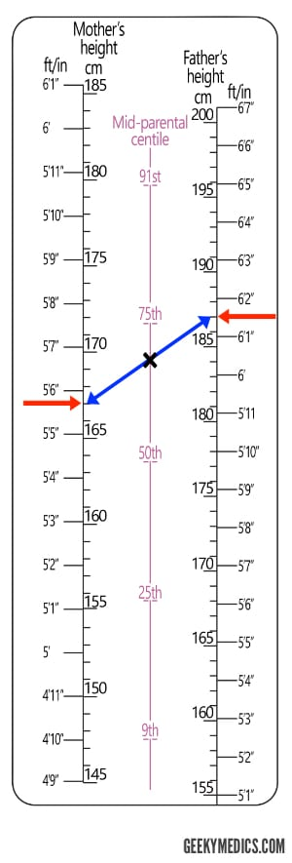

Slide 53
Adult height predictor chart
The adult height predictor chart (Fig. 4) allows for a prediction of the child’s adult height based on their current height (adjusted to allow for very tall and short children to be less extreme as adults).
Predicting a child’s adult height
Plot the most recent height centile on the centre line and read off the predicted adult height for this centile.
80% of children will be within +/- 6cm of this value as adults.

Slide 54
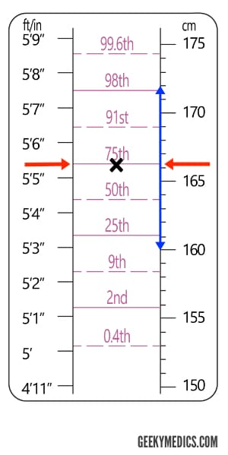

Slide 55
Pubertal assessment
The 2-18 years growth chart contains puberty lines from age 8 to 18 years old for girls and 9 to 18 years old for boys.
These lines indicate the normal age limits for the phases of puberty.
Girls
Pre-puberty
Tanner stage 1
In puberty
Tanner stage 2 & 3
Completing puberty
Tanner stage 4 & 5
No signs of pubertal development.Any breast enlargement, pubic or armpit hair.Started periods with signs of pubertal development.

Slide 56
Interpretation
Puberty before 8 years old in girls is likely to be precocious and further investigation is necessary.
If a patient is between 8-13 years old and is plotting within the shaded area of the chart for their height centile, pubertal assessment is required, and mid-parental centile should be assessed.
If they are “In puberty” or “Completing puberty” – they are BELOW the 0.4th centile and should be referred for further investigation.
If “Pre-pubertal”, they are generally growing normally but should be compared to their mid-parental centile.
If there are no signs of puberty by 13 years of age, then puberty is delayed and further assessment is indicated.
If the patient is older than 16 years old and not in the “completing puberty stage”, maturation is delayed, and further investigation is required.

Slide 57
Boys
Pre-puberty
Tanner stage 1
In puberty
Tanner stage 2 & 3
Completing puberty
Tanner stage 4 & 5
If both of the following:
High voice
No signs of pubertal development
If any of the following:
Slight deepening of the voice
Early pubic or armpit hair growth
Enlargement of testes or penis
If any of the following:
Voice fully broken
Moustache and early facial hair growth
Adult size of penis with pubic and axillary hair

Slide 58
Interpretation
Puberty before the age of 9 years in boys is likely to be precocious and further investigation is necessary.
If a patient is between 9-14 years old and is plotting within the shaded area of the chart for their height centile, pubertal assessment is required and mid-parental centile should be assessed.
If they are “In puberty” or “Completing puberty” – they are BELOW the 0.4th centile and should be referred for further investigation.
If “Pre-pubertal”, they should be referred for further investigation and compared to their mid-parental centile. After investigation, these children are often found to be growing normally.
If there are no signs of puberty by 14 years of age, then puberty is delayed and further assessment is indicated.
If the patient is older than 17 years old and not in the “completing puberty stage”, maturation is delayed, and further investigation is required.

Slide 59
BMI centiles
The growth charts also provide an opportunity to calculate the child’s BMI from the age of 2.
Both 0-4 years (boys & girls) and 2-18 years (boys & girls) charts provide a simple graph to convert the child’s weight centile and height centile to their BMI centile.
Interpretation
A child whose weight is average for their height will have a BMI between the 25th and 75th centiles, whatever their height centile.
A BMI above the 91st centile suggests the child is overweight.
A BMI above the 98th centile is very overweight (clinically obese).
A BMI below the 2nd centile is unusual and may reflect undernutrition requiring further investigation. In older children, this may simply reflect a small build.

Slide 60
Reading the Charts
Say you have a 2-year-old boy who weighs 30 pounds. To find out what his percentiles are, start by using the CDC growth chart for boys from birth to 36 months.
This chart, like all the others, has the age at the top and bottom of the grid and length and weight at the left and right of the grid. Curves on the chart indicate the percentiles for length-for-age and weight-for-age.
Step A: Find the child's age at the bottom of the chart and draw a vertical line on the growth chart (from top to bottom). For this example, you would draw a line through 24 months (2 years).
Step B: Now find the child's weight on the right-hand side of the chart, 30 pounds in this example, and draw a horizontal line (from left to right).
Step C: Find the spot where these two lines intersect or cross each other.
Step D: Find the curve that is closest to this spot and follow it up and to the right until you find the number that corresponds to your child's percentile.

Slide 61
In this example, you can see that a 2-year-old boy who is 30 pounds is at the 75th percentile for his weight, meaning that in a population of children growing optimally, he weighs more than about 75% of boys his age.
Finding a child's percentile is a little harder if the curve doesn't actually pass through the spot where age and weight come together. For example, if the boy in the example weighed 31 pounds, you would use all of the same steps but also have to imagine a curve that is somewhere between the 75th and 90th percentiles, figuring that he was at about the 80th to 85th percentile.
You can use the same steps to plot your child's height and body mass index (for kids ages 2 and up).

Slide 62
Growth charts for children with Down syndrome
The Down Syndrome Medical Interest Group (DSMIG) and RCPCH have developed cross-sectional growth charts for boys and girls with Down syndrome for use from term to 18 years old.
Reasons for using these charts include:
Short stature is a recognised characteristic of most people with Down syndrome – the average height at most ages is around the 2nd centile for the general population.
These children are at increased risk of additional medical conditions that may interfere with growth (e.g. congenital cardiac disease, sleep-related upper airway obstruction, coeliac disease, feeding issues and thyroid hormone deficiency).
Regular measurements in combination with a general health assessment, nutritional and thyroid status are likely to be sensitive initial indicators of such medical problems, allowing for early intervention.

